Slide 1
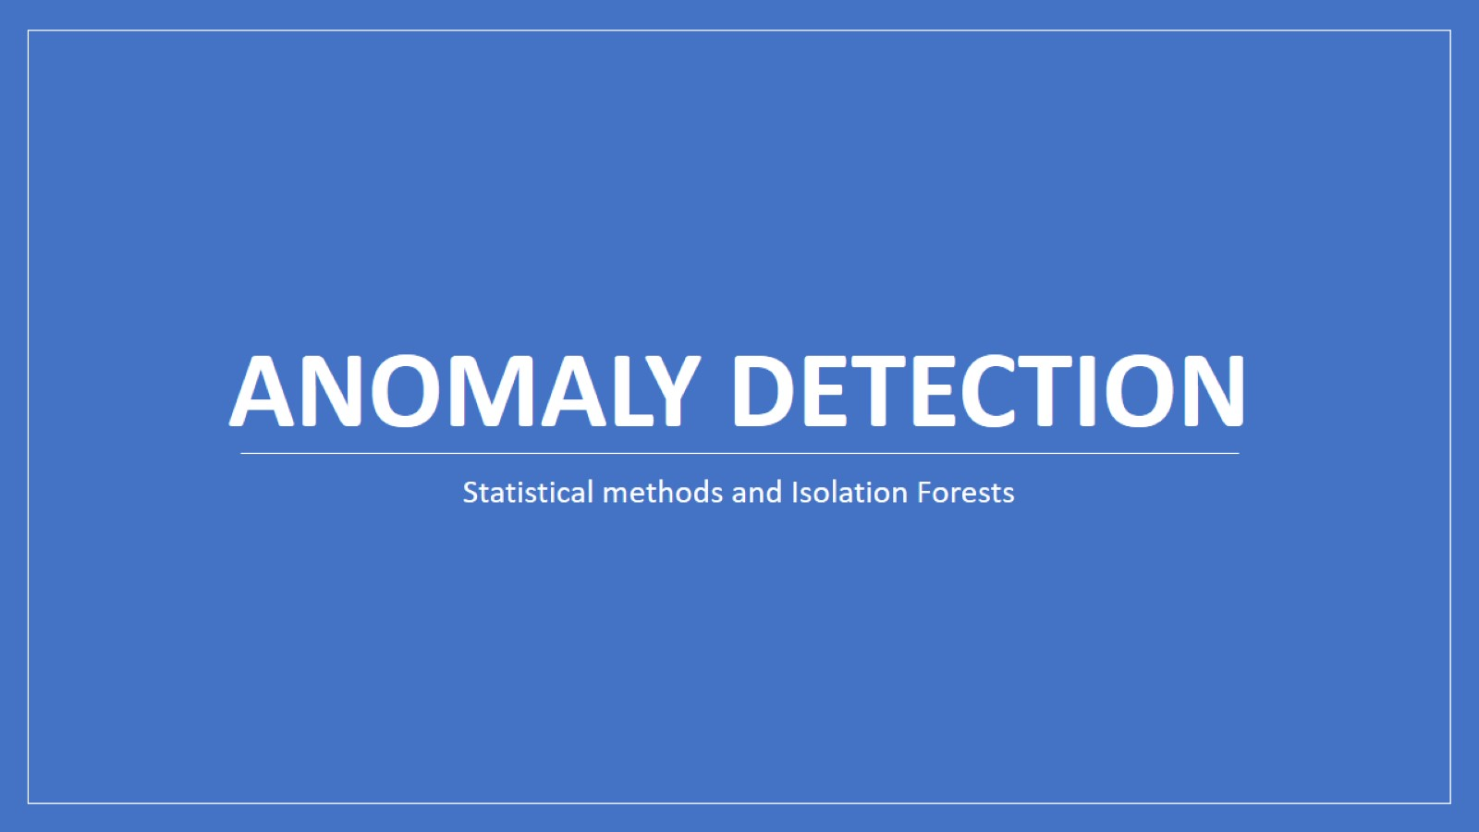
Anomaly Detection

Slide 2
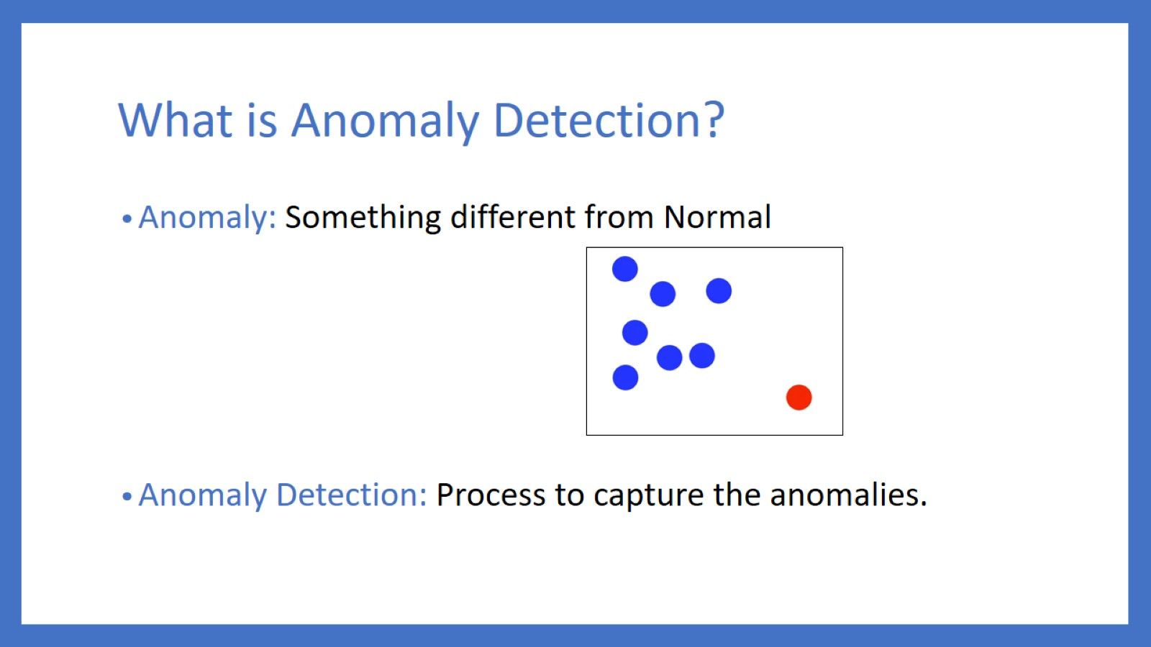
What is Anomaly Detection?

Slide 3
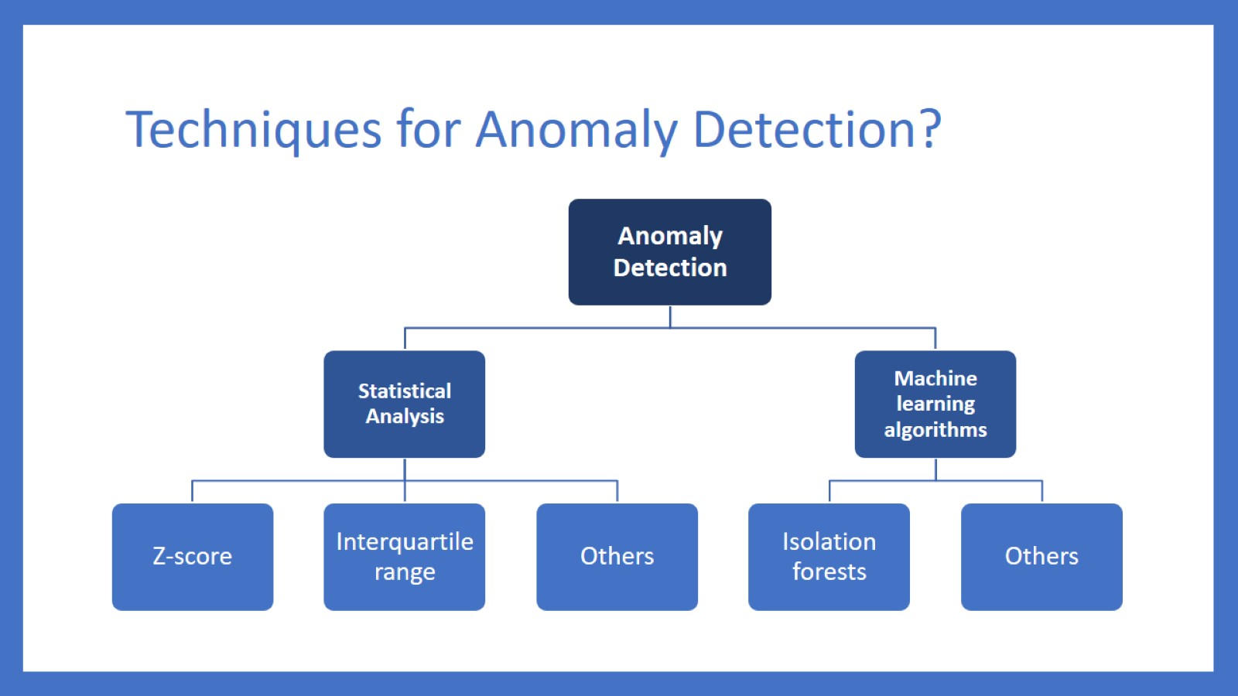
Techniques for Anomaly Detection?

Slide 4
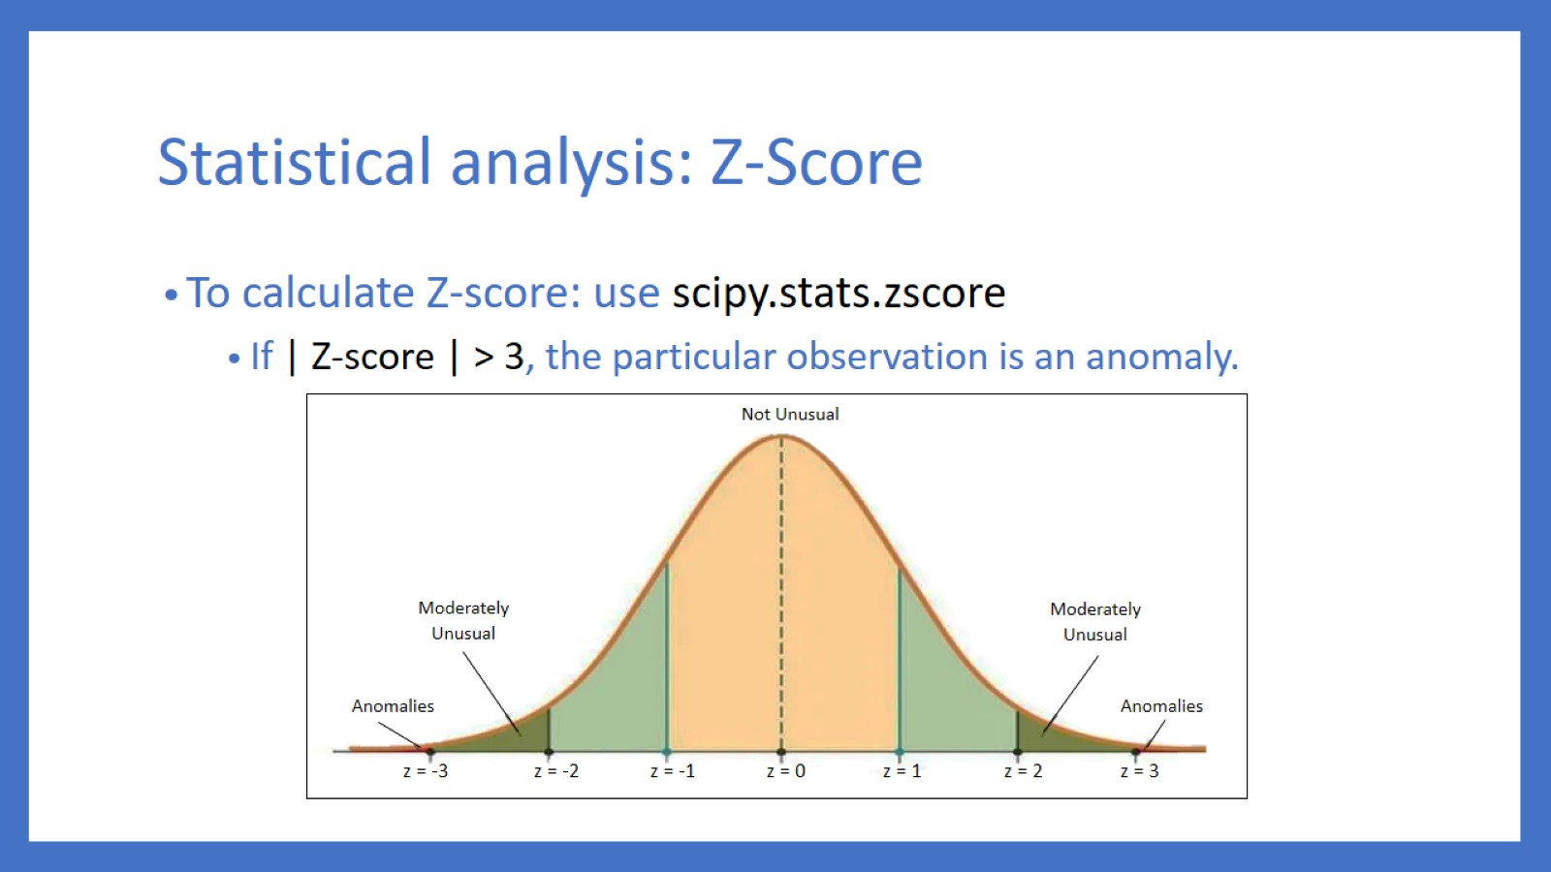
Statistical analysis: Z-Score

Slide 5
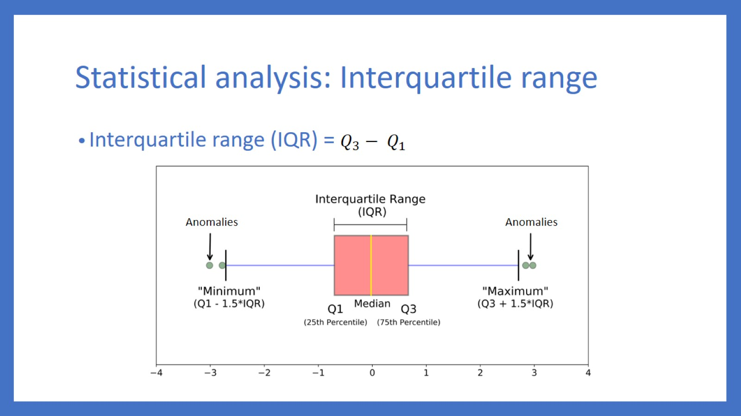
Statistical analysis: Interquartile range

Slide 6
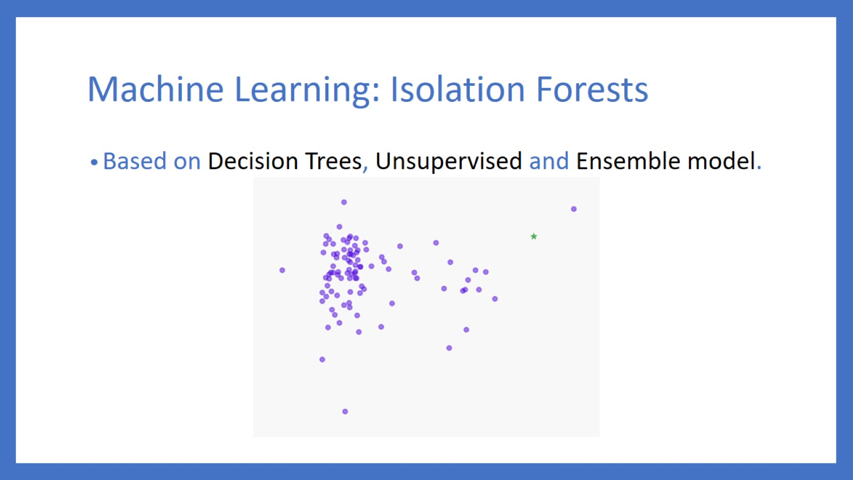
Machine Learning: Isolation Forests

Slide 7
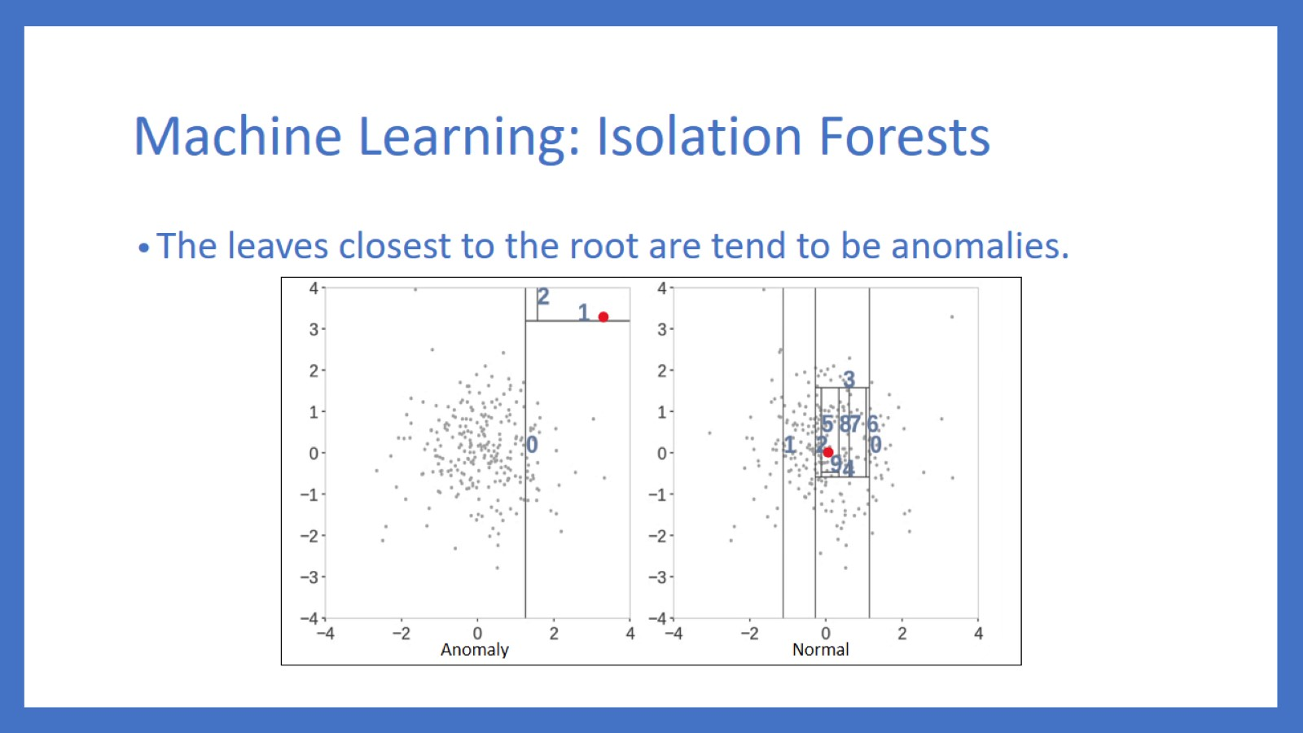
Machine Learning: Isolation Forests

Slide 8
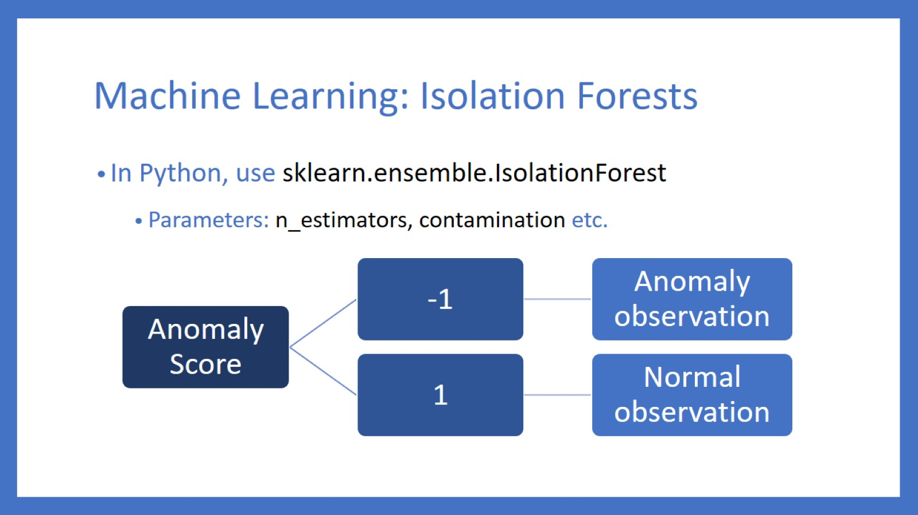
Machine Learning: Isolation Forests

Slide 9
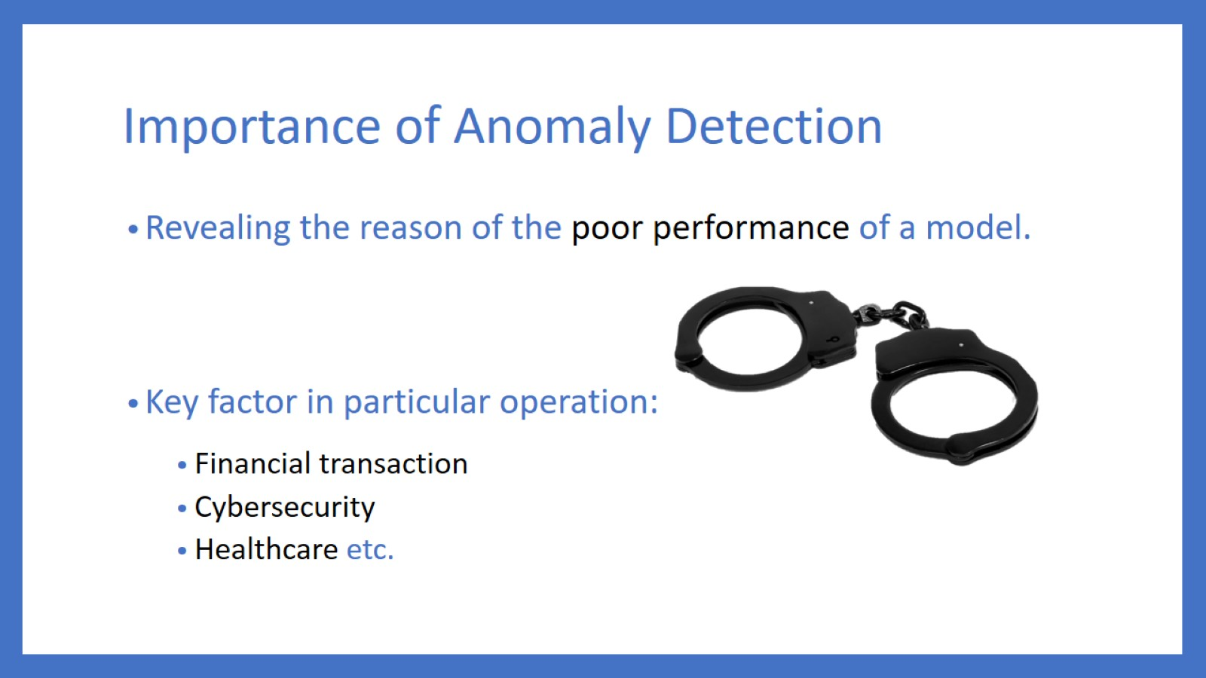
Importance of Anomaly Detection

Slide 10

Thank you

